Slide 1



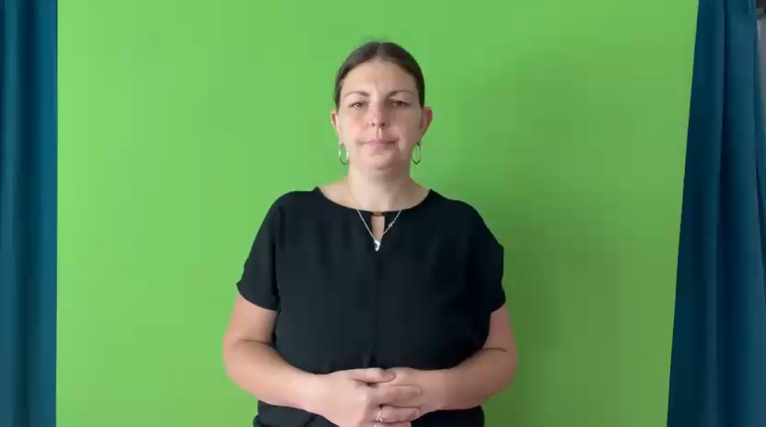
Looking After You Too Bite Sized
WELCOME
Episode 1

Slide 2
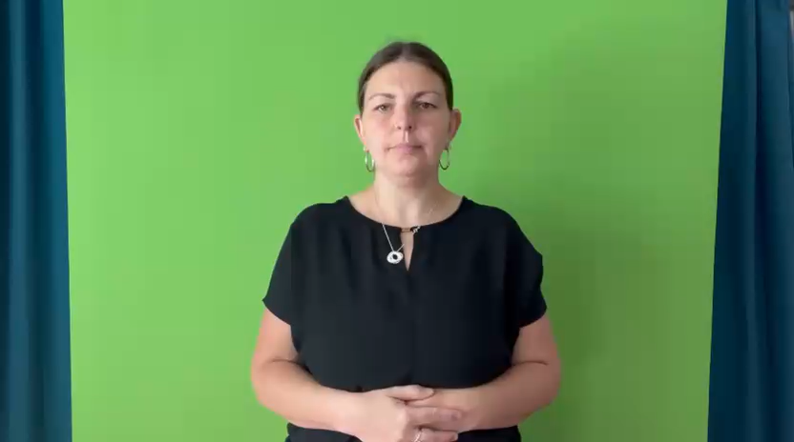
Introduction
Parent Carer Role: Impact
Parent Carer Role: What helps
Looking After You Too
Stress
Anxiety
Depression

Slide 3
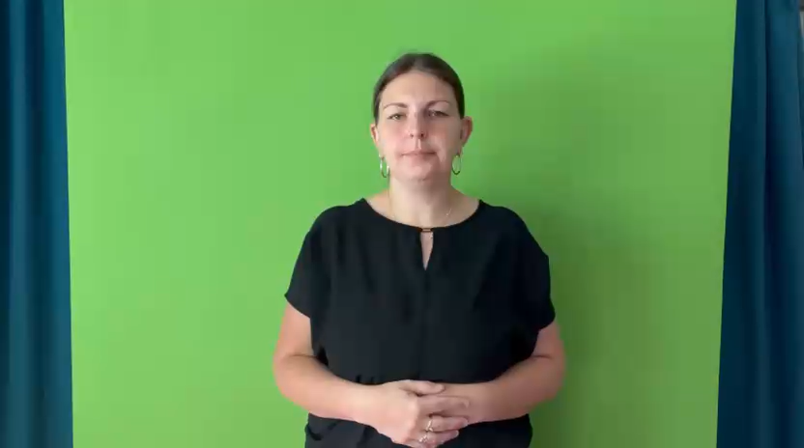
Parent Carer Feedback
Personal growth, more authentic connection, focus on what’s important in life, “better person”
Fighting for service
Being disbelieved
Feeling de-skilled
Stigma/Prejudice
Gap between expectation & reality
“Emotional Rollercoaster”
Stress, poor health

Slide 4
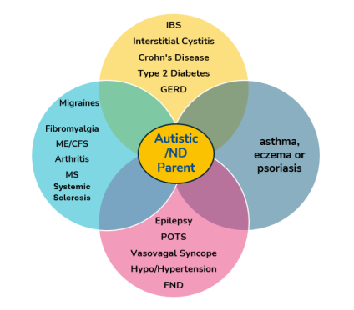

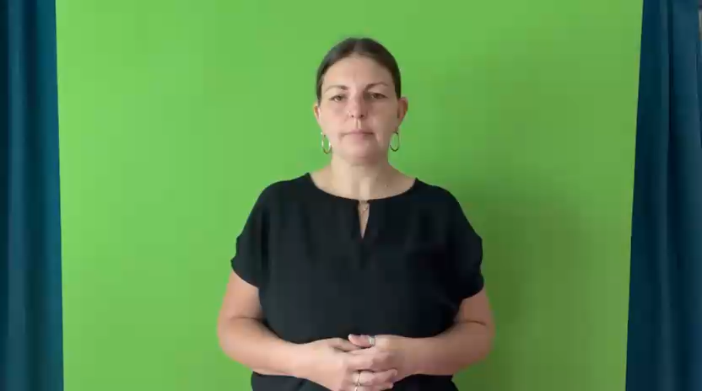
Looking After US Too Report
Health Inequalities for Parents of Autistic Children & Young People
Multiple mental and physical health conditions
Barriers to accessing treatment and support
Inaccessible services
STRESS.

Slide 5
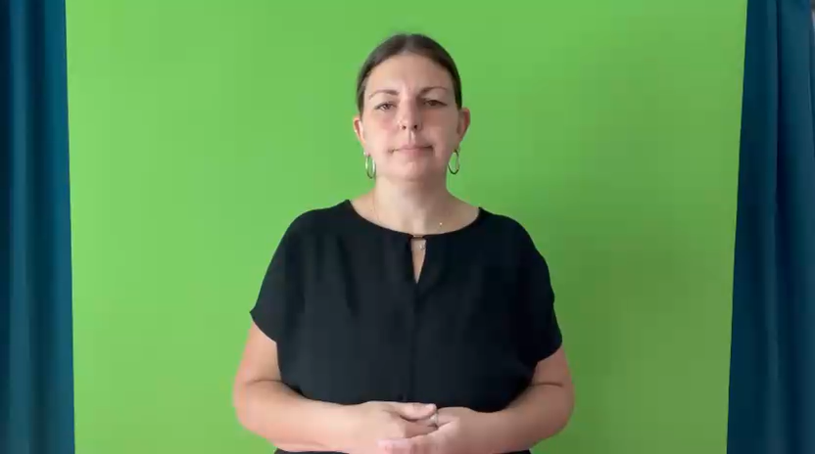
Looking After You Too
Reducing Isolation – You are not alone
Looking after self to look after others
Better self-care
Less Self Blame
Increased confidence in parenting
Better able to manage difficult emotions

Slide 6
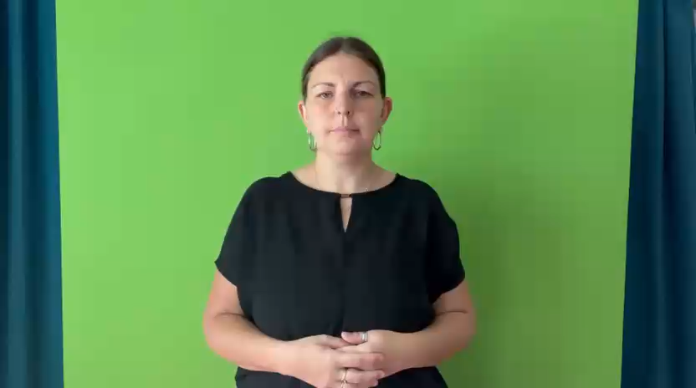
Looking After You Too
Stress and anxiety management
Low mood management
Key resilience skills
Feedback from peers
Signposting

Slide 7
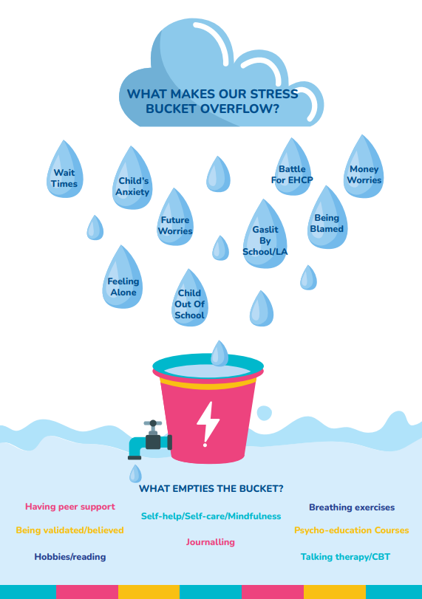
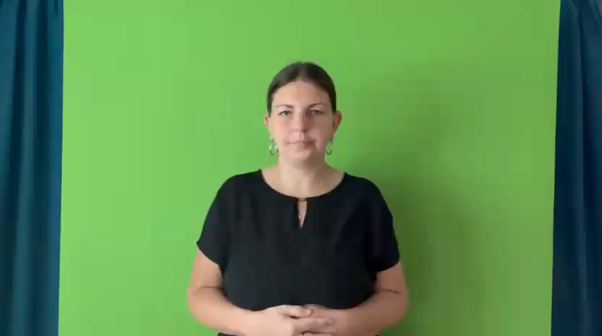
Stress

Slide 8
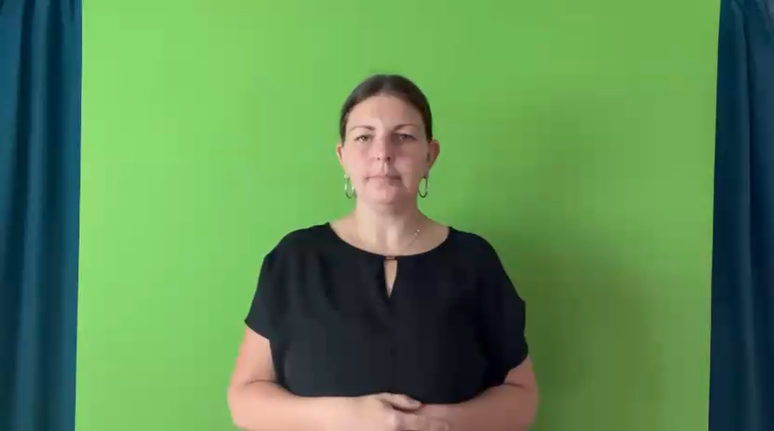
What is anxiety?
Body
Fight or Flight
Mood
Threat detection
Worry
Catastrophising
Mind reading

Slide 9
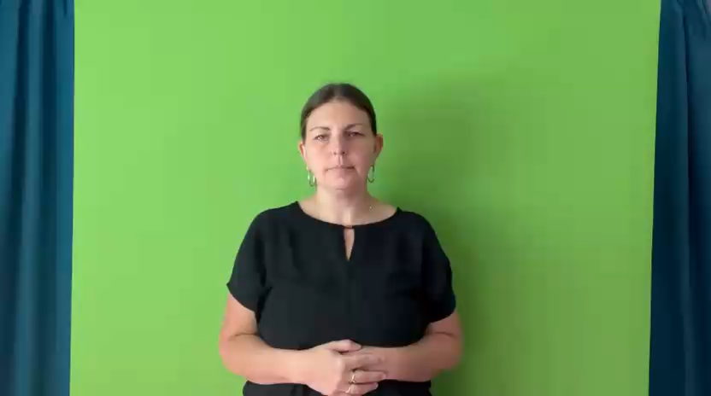
What is depression?
Body
Negative filter
Low Motivation
Loss of pleasure/interest
Hopelessness
Self-blame /criticism
Risk

Slide 10
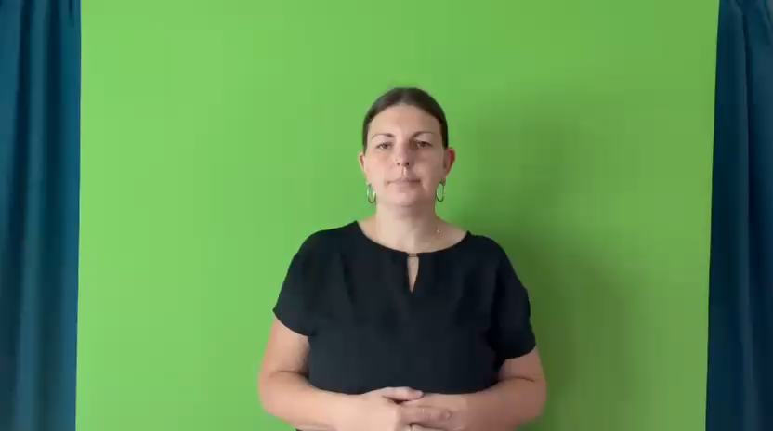
Mental Health Support
GP
Text 'SHOUT' to 85258
116 123 Samaritans (24/7)
NHS 111/999
Free NHS Talking Therapies
in your area

Slide 11


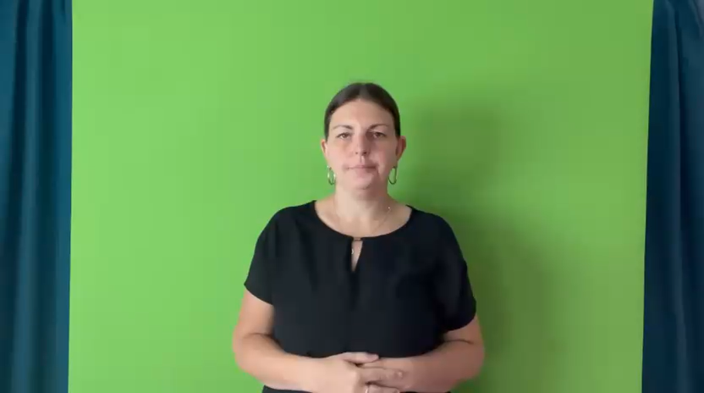

Our Looking After You Too courses are made possible by grants
We are proudly part of and supported by:

